Slide 1

Sage ERP X3 – POS Integration through WEB SERVICE
Nest Information Technologies (P) Ltd.

Slide 2
Index
Introduction
Slide 3
Functional Summary
Slide 4
Setting Up to Process a Sales Order through a Web Service
Slide 5-6
X3 Console – Web Server/Web Services
Slide 7
X3 Console –Web Services Pool Configuration
Slide 8
Creating a new pool
Slide 9
Web service pool screen
Slide 10
Creating Web Service in X3
Slide 11
Import Template
Slide 12-13
Template File
Slide 14
X3 Tasks & Process for POS integration
Slide 15
Java Development
Slide 16-17
Main Classes associated with X3WEBSERVICE
Slide 18
Important log files
Slide 19
Other Tasks
Slide 20-21
Recurring Task Management
Slide 22
Automatic Payment
Slide 23

Slide 3

Introduction
If you are in a retail/supply chain business and your ERP X3 software and POS software are not integrated you're probably doing redundant work or you're missing the boat completely. Some of the typical benefits of using a fully integrated point of sale system below
Deliver access to live data
Provide valuable sales and stock information
One database to maintain
Real time reporting

Slide 4
Functional Summary
NeST designed the X3-POS integration via recurring batch server tasks in X3, which will call Sage standard batch tasks and trigger the following transactions automatically to recur every few minutes.
Now NeST implemented the X3-POS integration via WEBSERVICE and PAYMENT through JAVA which increases our system’s speed and efficiency.
Automatic creation of sales order from a file input coming in from POS system as per given import template through Web service.
Automatic creation of work order from Sales Orders generated with POS data for each product coming from POS, including the start and end times in POS for each product line through Web service.
Work order time update to update POS Start and End timestamps from Sales order product lines
Work order tracking
Work order closure
WO Cost calculation
Work order WIP posting
Stock Interface update
Automatic sales invoice creation is through Web service
Sales invoice validation
Automatic payment creation is through Web service

Slide 5

Setting Up to Process a Sales Order through a Web Service
To check X3 web service license
Development > Utilities > Verifications> Display License
The Display License shows the available options that can be executed through the X3 applications.
Notice, the web services section circled below.
This value indicates the number of concurrent web services that may be executing in an X3 Runtime.
The value must be non-zero to run a web service connection.
You can see a screen like below

Slide 6
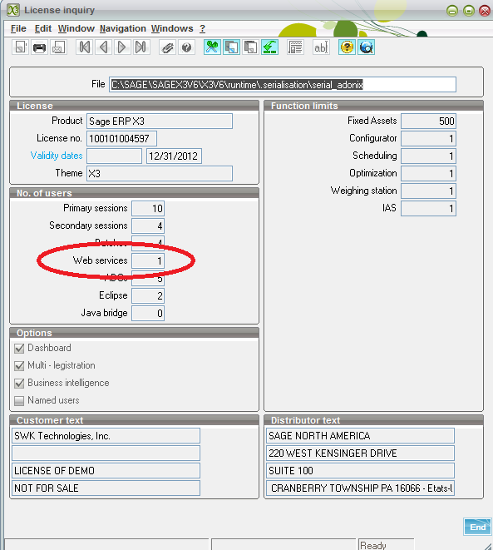
Setting Up to Process a Sales Order through a Web Service

Slide 7
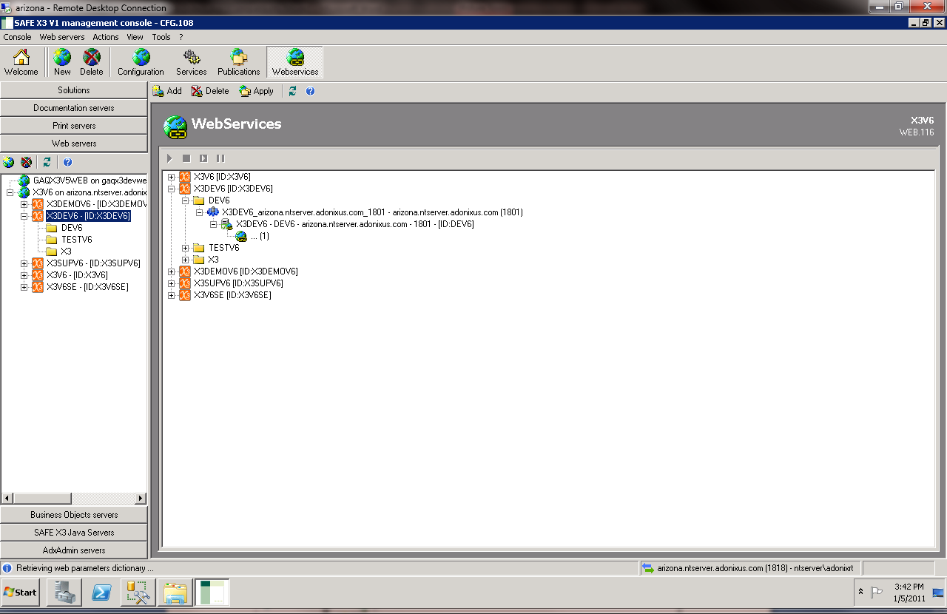
X3 Console – Web Server/Web Services
The next step is to configure the web service connection in the console.

Slide 8
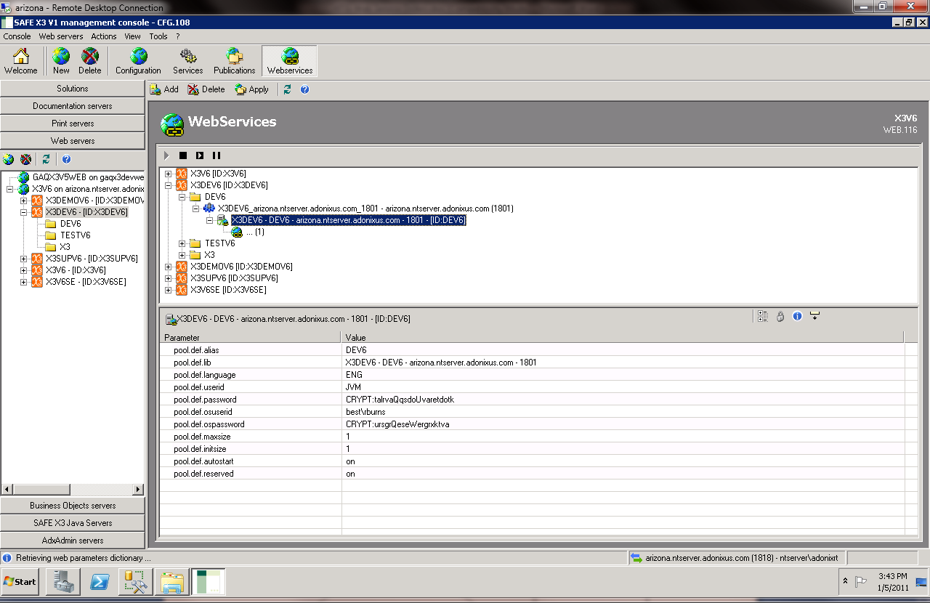
X3 Console –Web Services Pool Configuration
Select or define a pool.
A pool is a collection of connections into X3 as limited by the license.
For example, there can be 1 pool that supports 5 concurrent connections into X3.
The length of the outstanding requests to a pool is managed by minimizing the length of the queue against any one of the connection streams. (I.e., if there are 5 connections in the pool and 10 outstanding requests, the length of the queue to any one of the connections is 2.)
Pool information must be defined for the web service in addition to having a license

Slide 9
Creating a new pool
“pool.def.alias” fill this field by giving a pool name .
“pool.def.lib” It will automatically appear on the screen
“pool.def.language” Fill this with X3 Lang
“pool.def.username” Fill this with X3 username
“pool.def.password” Fill this with X3 password
“pool.def.osuserid” Fill this with os user id
“pool.def.ospassword” Fill this with os password
“pool.def.maxsize” Fill it as ‘1’
“pool.def.initsize” Fill it as ‘1’
“pool.def.autostart” Fill it as ‘on’
“pool.def.reserved” Fill it as ‘on’
After setting all theses values click apply button then the pool will be created. To check out the created pool go to
Development → Utilities →Miscellaneous → Web service pool
There you can see your WEB SERVICE pool like below screen.

Slide 10
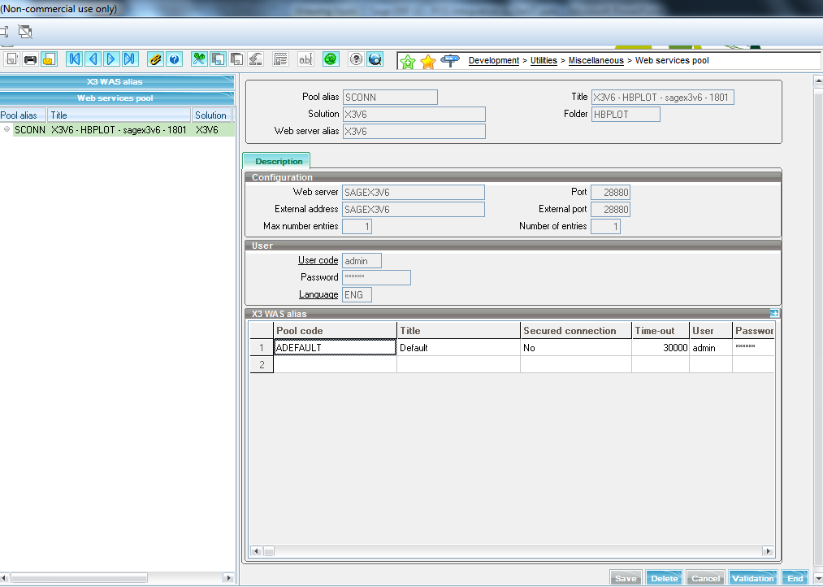
Web service pool screen

Slide 11
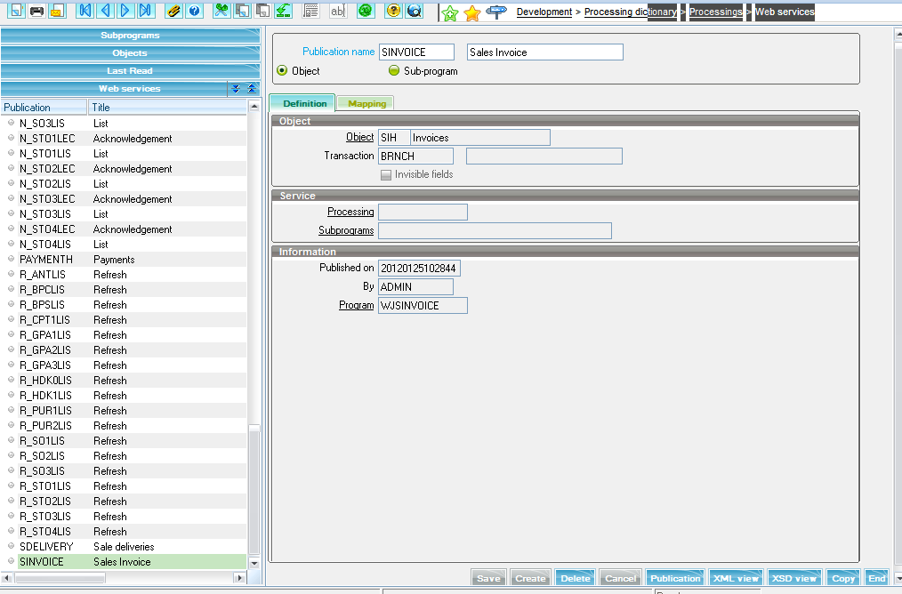
Creating Web Service in X3
Development → Processing Dictionary → Processings →Web services

Slide 12
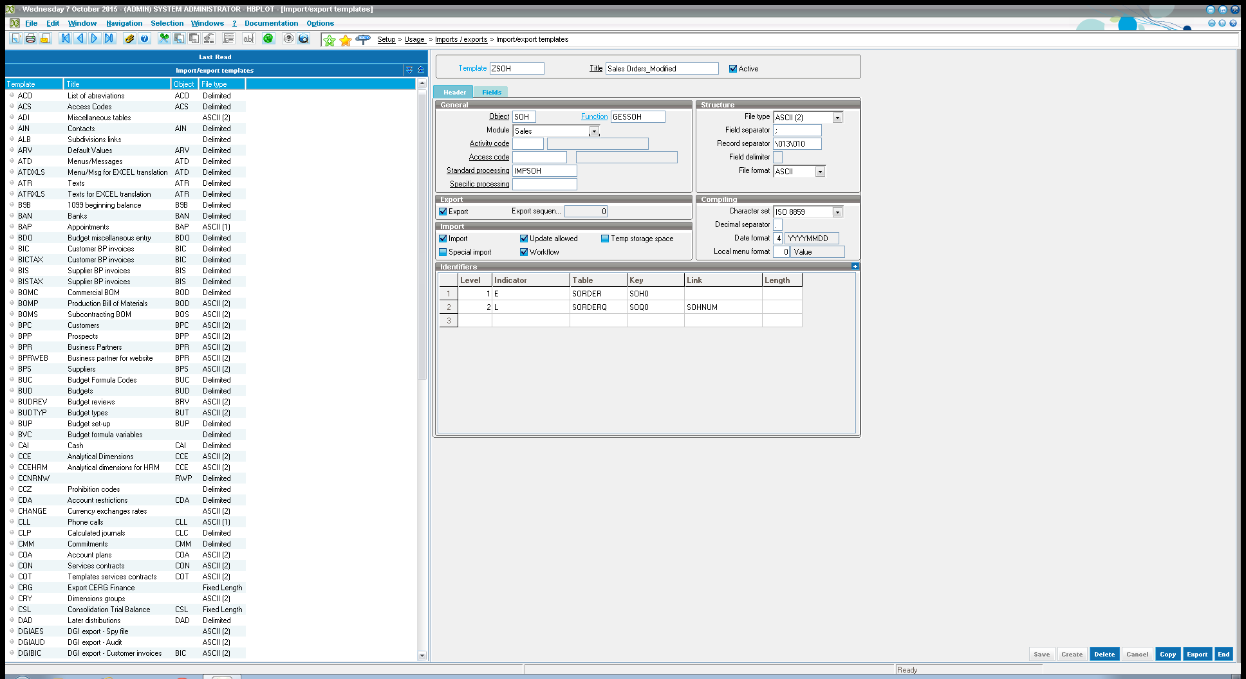
Import Template
Sage X3 provide comprehensive import/ export functionalities.
Using this feature we have created a template for importing POS sales data in to the X3.
Setup >Usage > Imports \ exports > import\export template

Slide 13
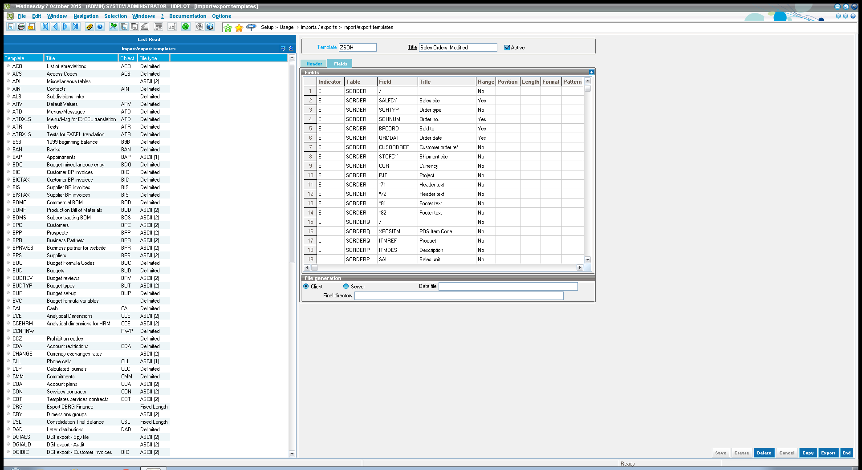
Import Template cont..
We need to add fields and its corresponding tables here. Semi column( ; ) is used to separate fields.
Indicator
E – Indicates header part , L – Indicates lines part

Slide 14

Template File
Consider that we have multiple stores in different locations. Sales data need to be prepared in text/excel file for each store using the above template. The file should contain all the necessary data such as Sales site, date, UPC, item name.
This file must be keep in C:\\WEBSERVICE folder with the name of SO2.txt.
Now our Web service and text file are ready.

Slide 15
X3 Tasks & Process for POS integration
Description | Task | Process | Process | MOD File | File Path
Sales Import | X3WEBSEVICE.class | SorderCreate.class
Auto WO creation | X3WEBSEVICE.class | WorderCreate.class
Cost Calculation | HBMWOCOST | XHBWOCOST |  | CALCSTSTD
WO Tracking | HBMTRACK | XFUNTRK |  | IMPTRK,IMPMAT,IMPOPE | C:\hb\
WO Time Update | HBWOTIM | XHBWOTIM
WO Close | HBMAUTWC | XFUNAUTC |  | FUNTDUCLO
WO WIP Posting | HBMAUTWP | XFUNAUTP |  | FUNWIPACC
Sales Invoice | X3WEBSEVICE.class | SinvoiceCreate.class
Sales Invoice Validation | HBMINVV | XFUNINVV |  | FUNCFMINV
Stock auto journal | HBSTKACC | XHBSTKACC |  | FUNSTKACC

Slide 16
Java Development
Now we have web services for salesorder,workorder,salesinvoice and payment.
Next step is to create JAVA application which performs the POS integration task and finally Payment.
From current X3 Tasks & Process we implemented a new java application named as X3WEBSERVICE and PAYMENT.
X3WEBSERVICE is a java application having subprograms for automatically creating sales order from the input file, Create work order from Sales Orders generated with POS data for each product coming from POS, including the start and end times in POS for each product line through Web service and create sales invoice.
PAYMENT is a java application which helps to create payment for invoicing items to pay through web service without a person’s interaction.
Then allow these class to communicate with web service and will do exactly the same what pos task did by submitting the tasks HBMSALES, HBMAUTWO,HBMINV.
Once we created X3WEBSERVICE and PAYMENT application we can make it as windows service.
Once we made our application as windows service it will run applications in the background as a Service.
We can check whether it is installed or not. Go to Start→Services
There will be X3WEBSERVICE and PAYMENT application as a windows service

Slide 17
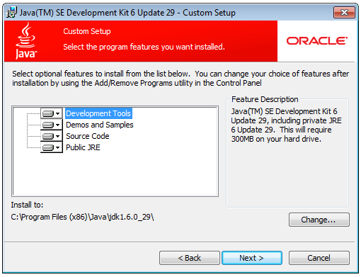
1. Install Java (JDK & JRE)

Slide 18
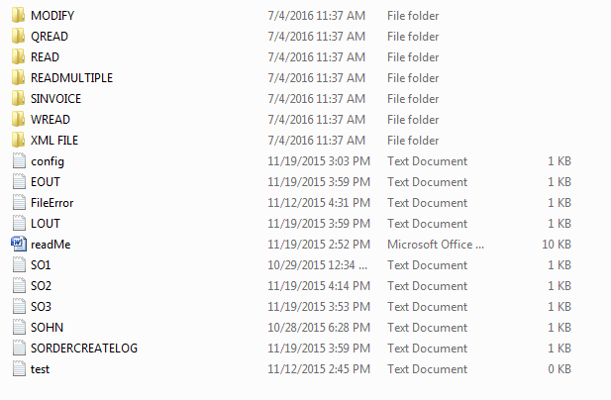
2. Place web service folder in C: drive
Copy the Sales order files from POS in to this folder

Slide 19
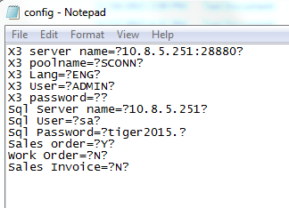
3. Config.txt
Define your server name, pool name, Lang, user, password, sql user and password in C\WEBSERVICE\config.txt

Slide 20
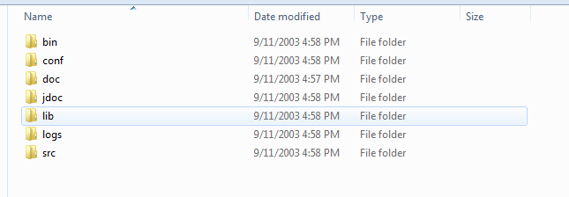
4. Extract ‘wrapper_win32_3.0.5’ to ‘C’ drive
Place X3WEBSERVICE.jar file in wrapper_win32_3.0.5→bin

Slide 21
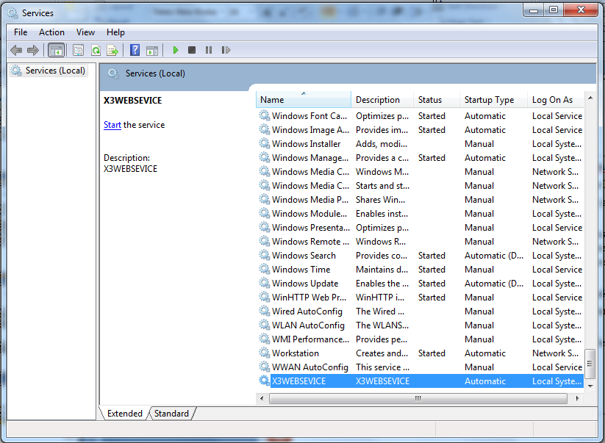
Java Development

Slide 22
Main classes associated with X3WEBSERVICE
In X3WEBSERVICE main class have mainly 3 sub classes.
SORDERCreate class for sales order creation.
WORDERCreate class for work order creation.
SINVOICECreate class for sales invoice creation.
PAYMENTCreate class for payment creation of invoiced items.
SORDERCreate class will create sales orders according to the information from the text file by passing XML input to the corresponding Web service.
WORDERCreate class will create work orders according to the information from the sales order by passing XML input to the corresponding Web service.
SINVOICECreate class will create sales invoice by passing XML input to the corresponding Web service.
PAYMENTCreate class will create payments for invoiced items by passing XML input to the corresponding web service.

Slide 23
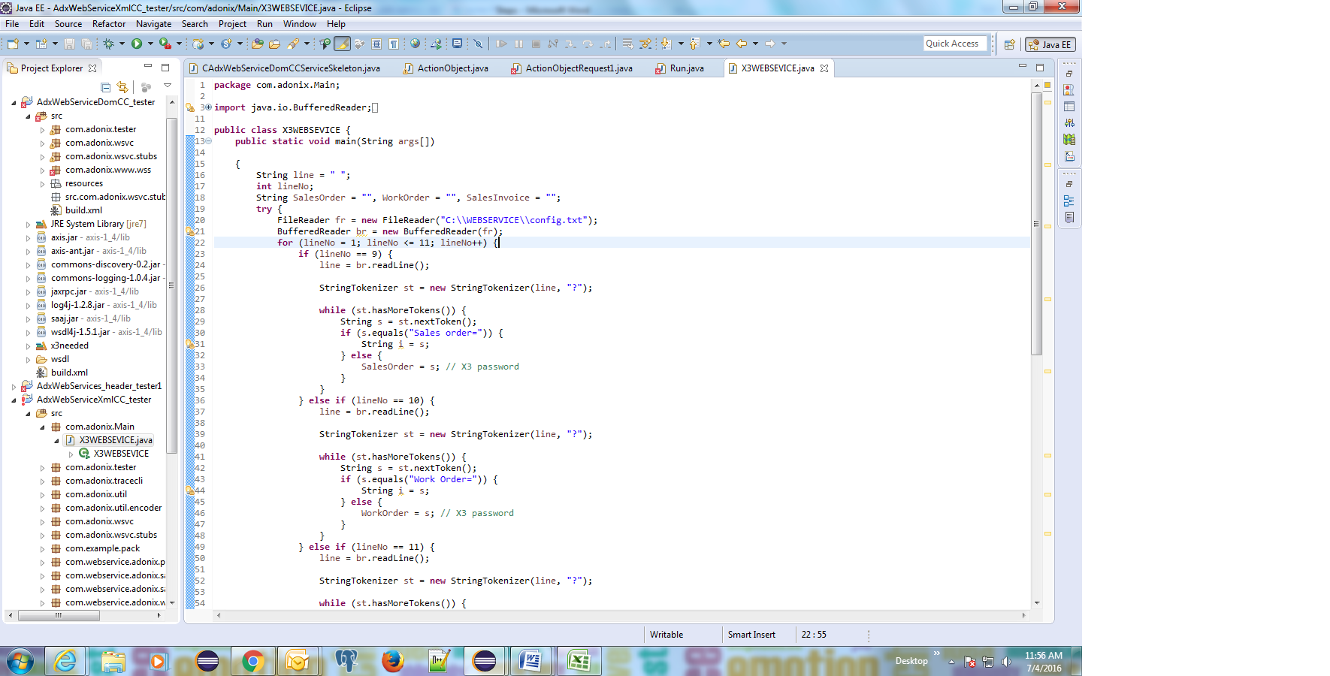
Source code Screenshot

Slide 24
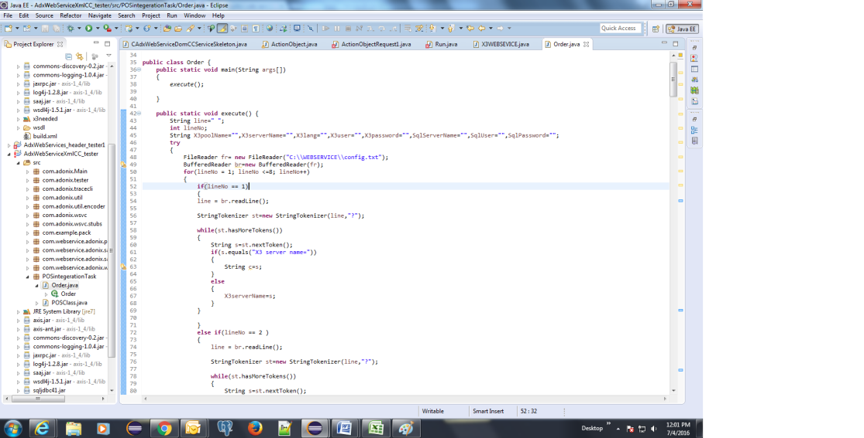
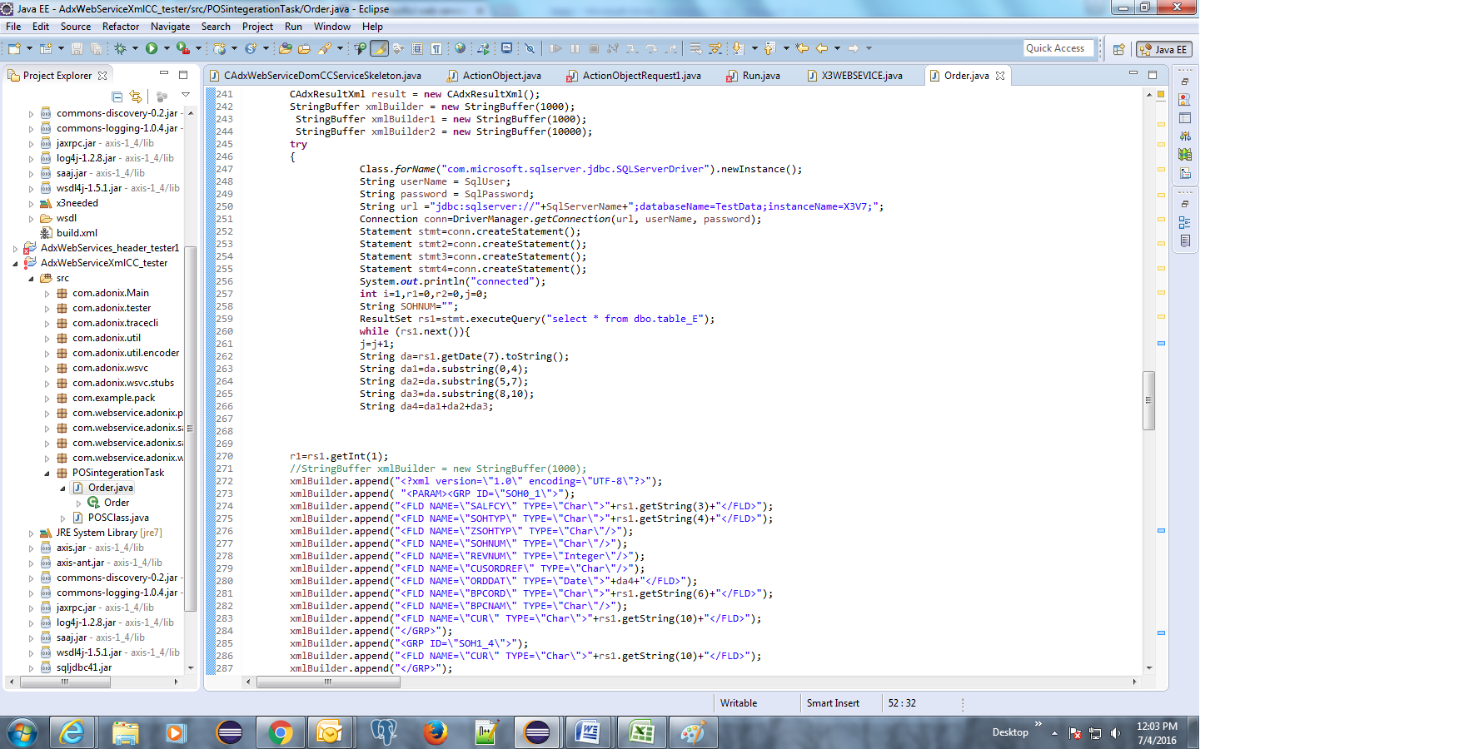
Order Creation code

Slide 25
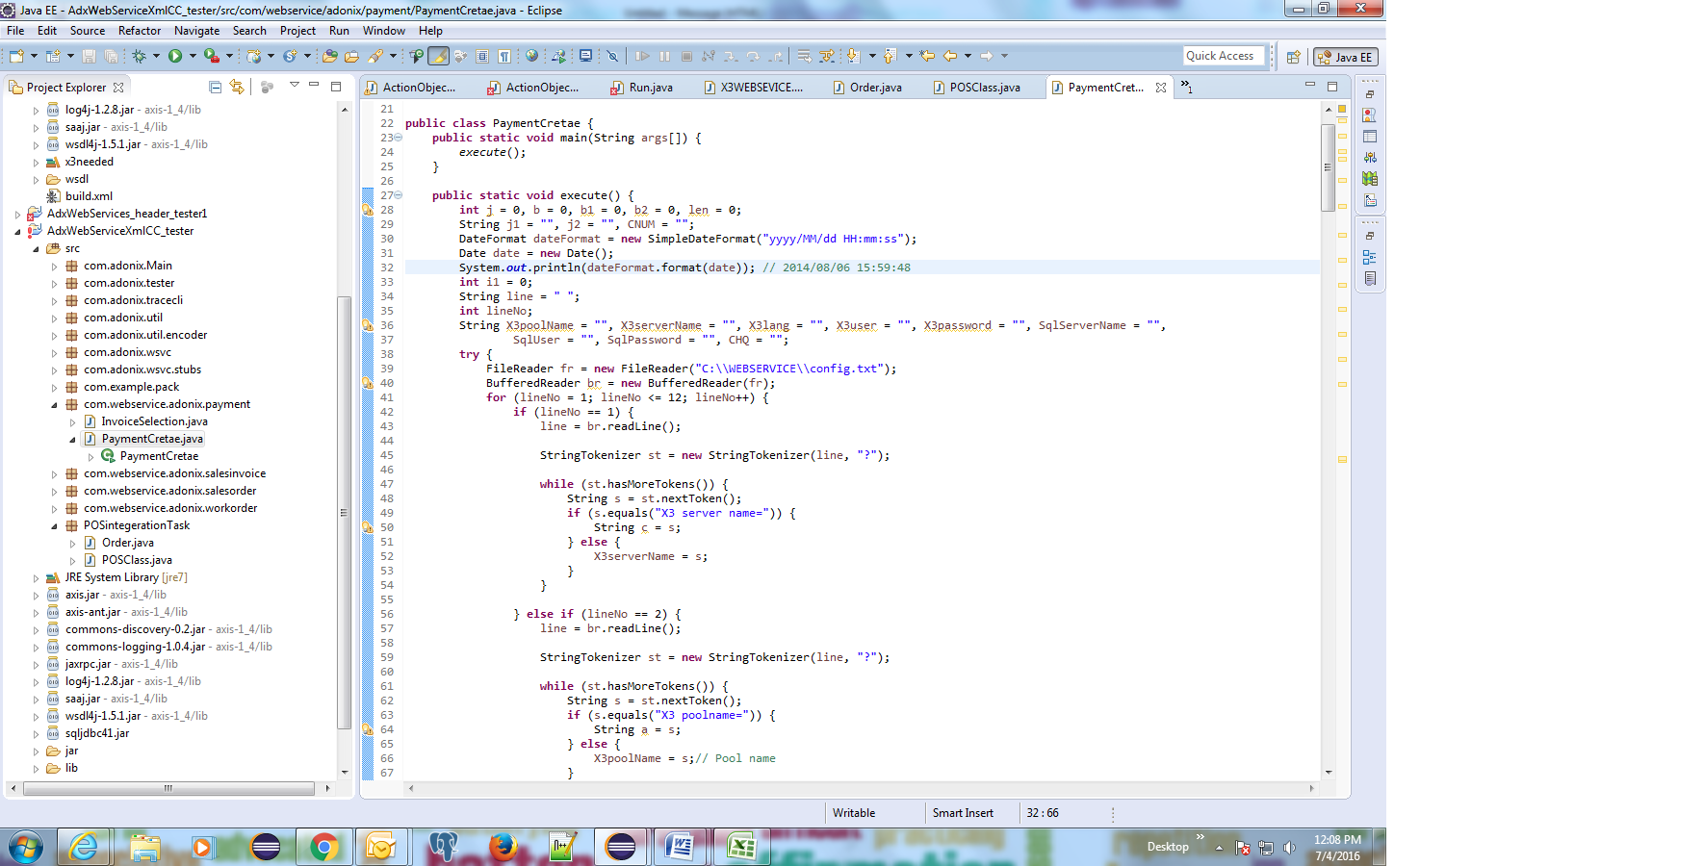
Payment creation code

Slide 26
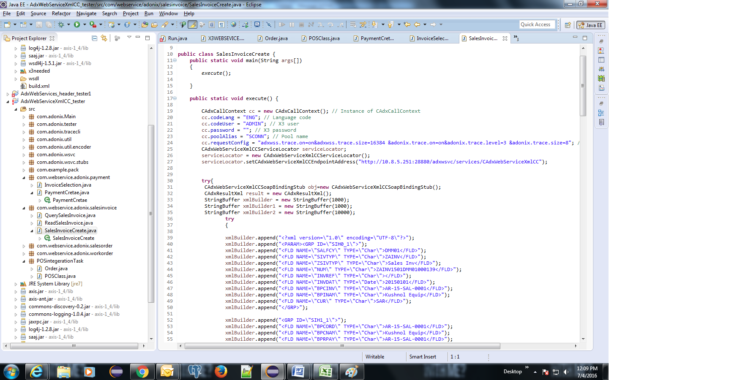
Sales Invoice Code

Slide 27
Important log files
After running this the created sales order numbers(SOHNUM) and the no of order created will be saved at SORDERCREATELOG.txt file in C:/WEBSERVICE.
Also the created sales orders xml file will be saved at C:/WEBSERVICE/XML FILE folder.
If there is any error occur during the creation it will be saved in FileError.txt file inside C:/WEBSERVICE

Slide 28
Other Tasks…
Work Order Time Update
The HBWOTIM task is created to update the entry time from Sales order into the corresponding work order. It also calculates the exit time based on the run time of the WO.
Work Order Tracking
HBMTRACK wrapper task calls standard X3 batch task for work order allocation and tracking. It calls the mod file of the standard X3 task and converts it to a .job file to do the functionality.
The mod file created in this task is IMPTRK.mod, IMPMAT.mod, IMPOPE.mod and job file is IMPTRK.job, IMPMAT.job, IMPOPE.job
Work Order Close
HBMAUTWC wrapper task is used to call standard sage X3 batch task for closing the work order and marking not as complete and ready for posting. The mod file created in this task is FUNTDUCLO.mod and job file is FUNTDUCLO.job

Slide 29
Other Tasks…
Cost Calculation
The wrapper task HBMWOCOST calls standard X3 batch task to do the costing process for the work order. The wrapper task executes the .mod file for the x3 batch task and converts it to a .job file so that it can run and do the functionality. The mod file created in this task is CALCSTSTD.mod and job file is CALCSTSTD.job
Work Order WIP Posting
HBMAUTWP wrapper task is used to call standard X3 task to do WIP posting, by calling its .mod file and creating a .job file which will execute it. The mod file created in this task is FUNWIPACC.mod and job file is FUNWIPACC .job

Slide 30
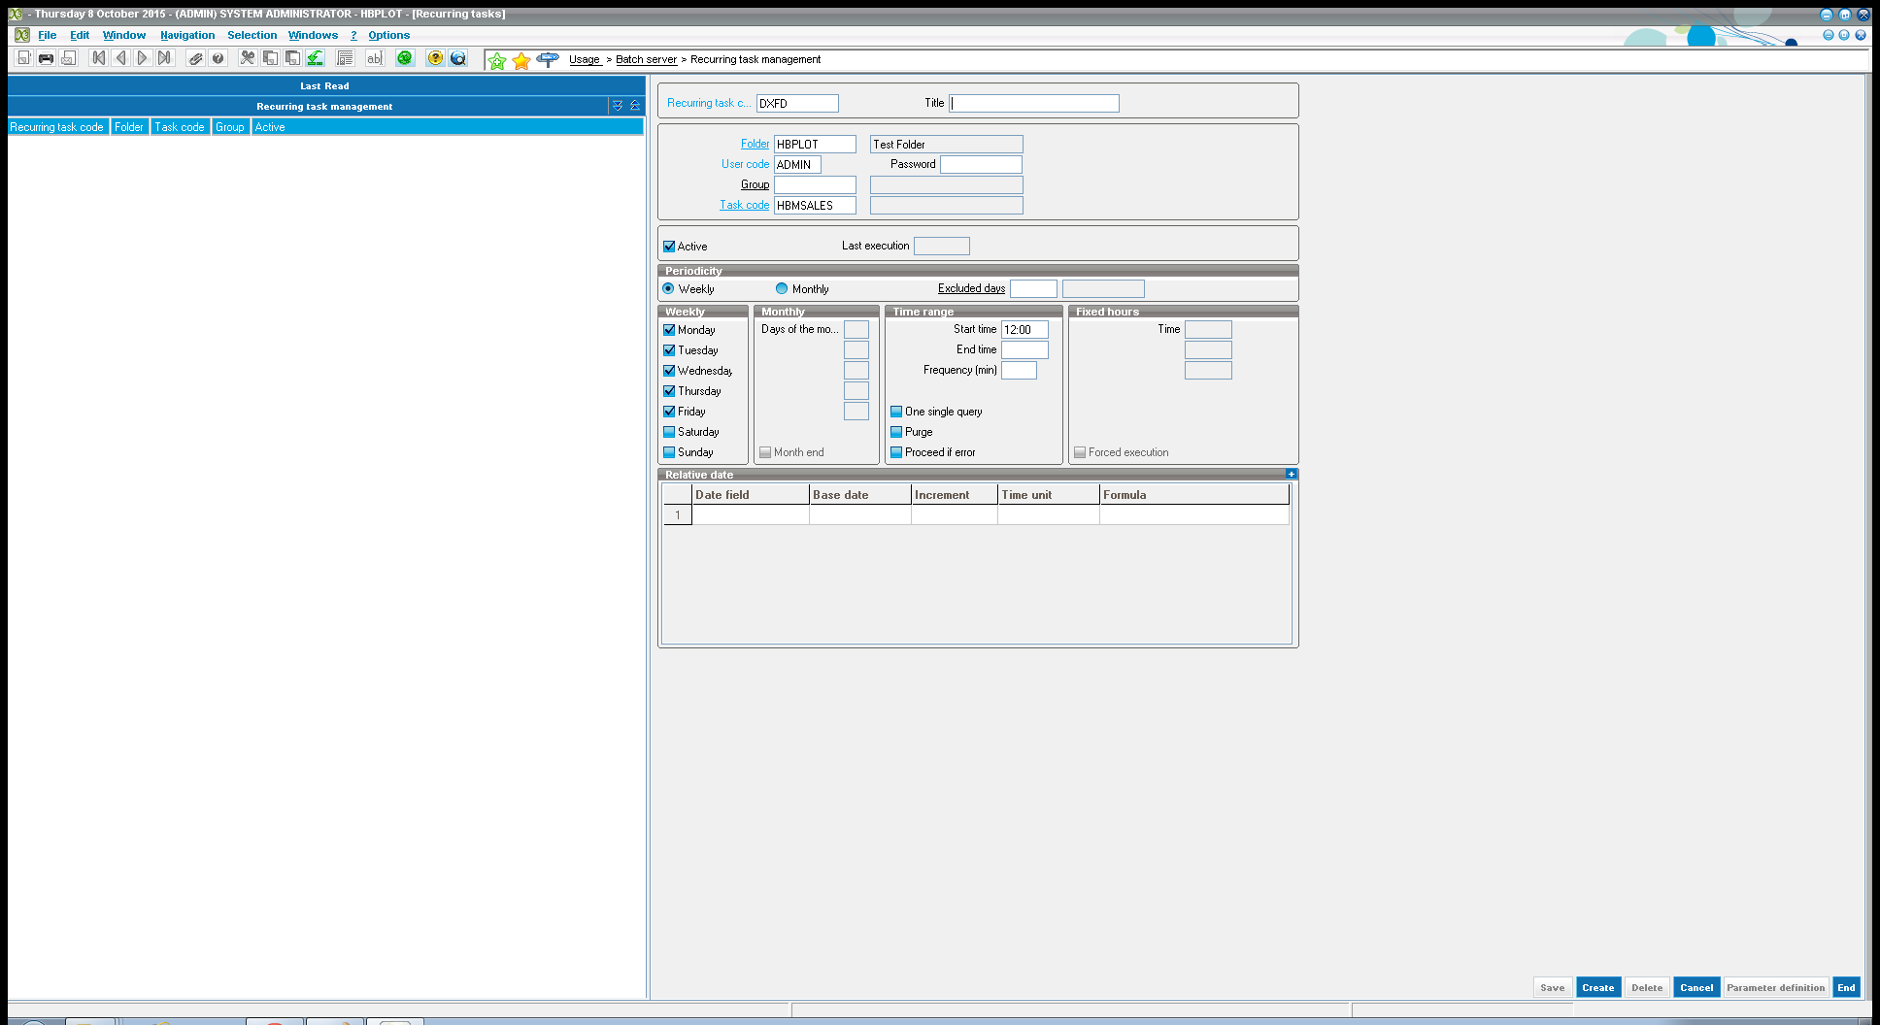
Recurring Task Management
No need to manually run all the tasks, Instead we can launched the tasks regularly by the batch server with help of recurring task management.
These recurring tasks will lead to a regular execution with a frequency that can be set up. Example -: Weekly, Monthly
Usage > Batch server > Recurring task management

Slide 31

Automatic Payment
After successful creation of all invoices, PAYMENT application will automatically create payment through web service by passing XML input.
For this we have a web service called ‘PAYMENT’ in SAGE ERP X3

Slide 32
Thank you
.

